Slide 1
Bias in the News
You can become more aware of bias by watching for the following journalistic techniques:
Selection & Omission
Placement
Headline
Word Choice/Tone
Photo, Captions and Camera Angles
Names and Titles
Stats & Crowd Counts
Source Control

Slide 2
Selection & Omission For example, if a few people boo during a speech, the reaction could be described as “remarks greeted by jeers” or ignored as “a handful of dissidents”

Slide 3
Placement *first = most important

Slide 4
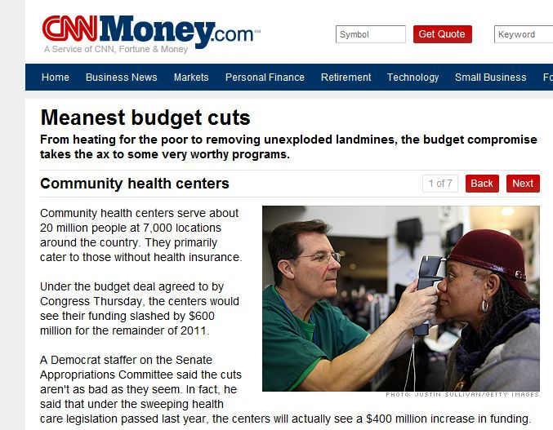
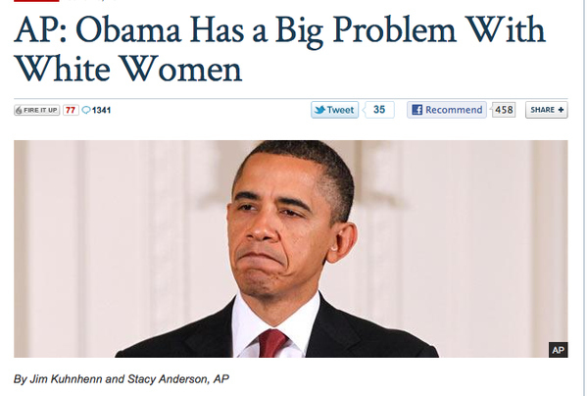
Headlines

Slide 5
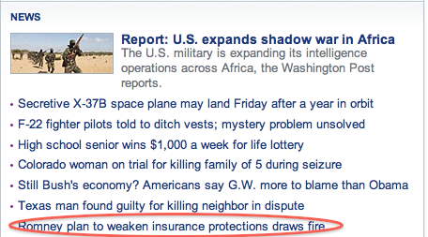
Word Choice/Tone

Slide 6
Photo, Captions & Camera Angles

Slide 7
Use of Names & Titles *Terrorist vs. Freedom Fighter *Ex-con vs. served 20 yrs ago for minor offense

Slide 8
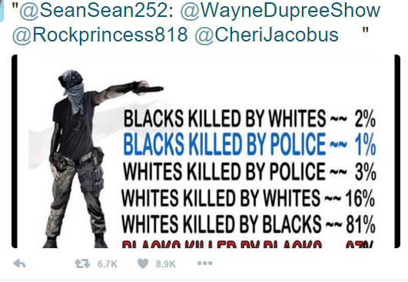
Stats & Crowd Counts *more than 900 people attended the event vs. fewer than 1,000 people showed up

Slide 9
Source Control *does the source have an agenda?

