Slide 1
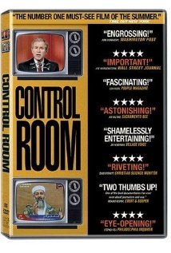
What happens when news media must rely on others for access to the story?

Slide 2
The Business of Journalism
How economics and capitalism shape news media
Today’s Goal:
Explore the effects of media conglomeration and de-regulation on the diversity (or lack thereof) in news media today
Notes:
Colbert explains AT&T mergers: http://www.ebaumsworld.com/video/watch/955486/

Slide 4
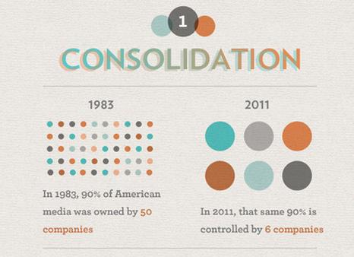
—Frugaldad.com

Slide 5
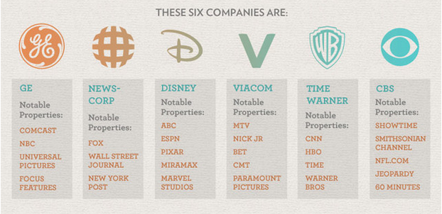
—Frugaldad.com
Notes:
Media mergers, regulation, and anti-trust measures are confusing to even legal scholars. Someone accessible, like Colbert, might be a good way to open the topic up with your students: Colbert explains AT&T mergers: http://www.ebaumsworld.com/video/watch/955486/

Slide 6
Private/market ownership model
Pros
Cons
No government control
Medium for anti-government views
Competition breeds ingenuity, better products
Large media companies benefit from economies of scale
Profit reigns supreme
Public interest secondary
Homogenization of voices because of convergence
Concentration of viewpoints
—globalization101.org
Notes:
This is the dominant model in the United States. However, some say the market model is undemocratic or unfair

Slide 7
Public sphere model
Pros
Cons
Publically-funded, so impetus to serve public interest
Provides resource regardless of ability to pay
Lack of competition
Lack of consumer support can derail product
—globalization101.org
Notes:
In the UK, for example, the BBC is a publically funded broadcasting company. Much like PBS in the United States

Slide 8
Ownership models & content
How do you balance ad revenue with journalistic obligation?
Would you run a story about a shady local business if they are also an advertising partner?
Notes:
Your school photo studio case study—photographer taking inappropriate photos of students.
This is THE essential dilemma with our commercial model—if what you print hurts the bottom line, do you change what you print?

